Slide 1
CCi Data Analyst Assessment

Slide 2
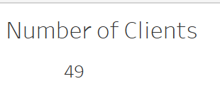
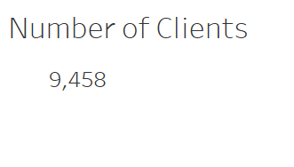
Client Counts
There are 49 distinct clients
There are 9 458 rows of clients in total because 1 client can write the assessment more than once.

Slide 3
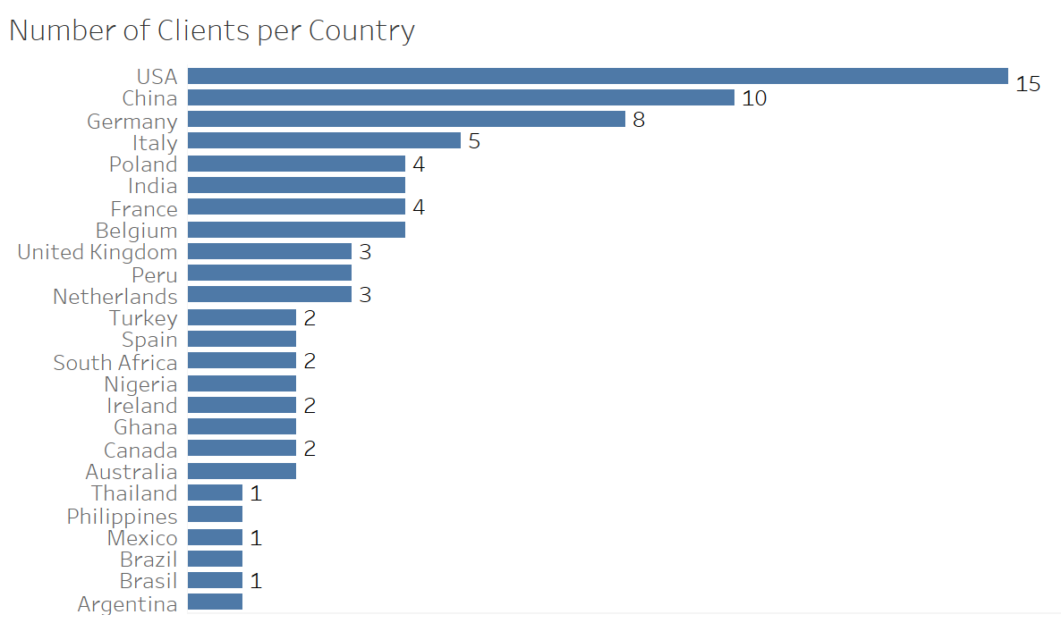
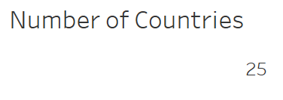
Number of Clients in Each Country
There are 25 countries in total.
USA has the highest number of clients, it has 15 distinct clients, while Thailand, Philippines, Mexico, Brazil, Brasil and Argentina have lowest, with 1 distinct client per country.

Slide 4
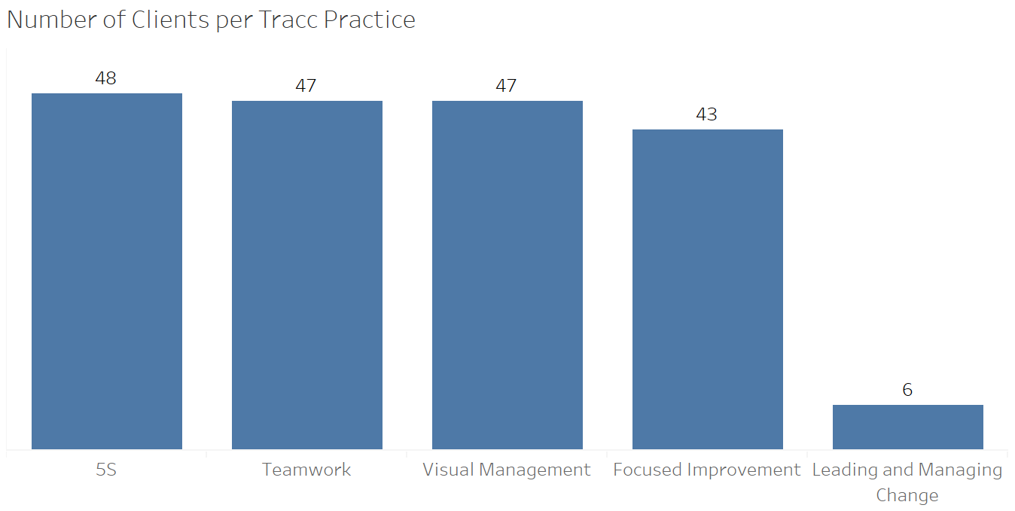
Clients Per Tracc_Practice
Of the 5 Tracc Practices, 5S has the highest number of clients while Leading and Managing Change has the lowest number, which could be indicating that more people still need to engage and practice leading and managing change more.

Slide 5
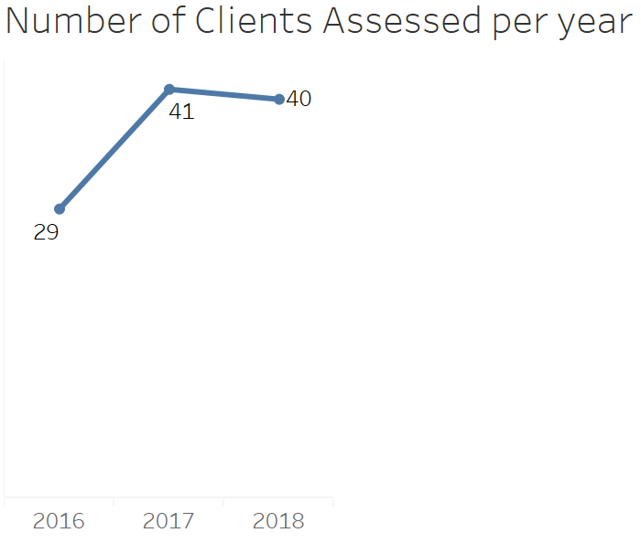
Clients Assessed Per year
The distinct number of clients that get assessed per year increased by 12 clients in 2017, then it decreased by 1 client in 2018, which was not really a big decrease.

Slide 6
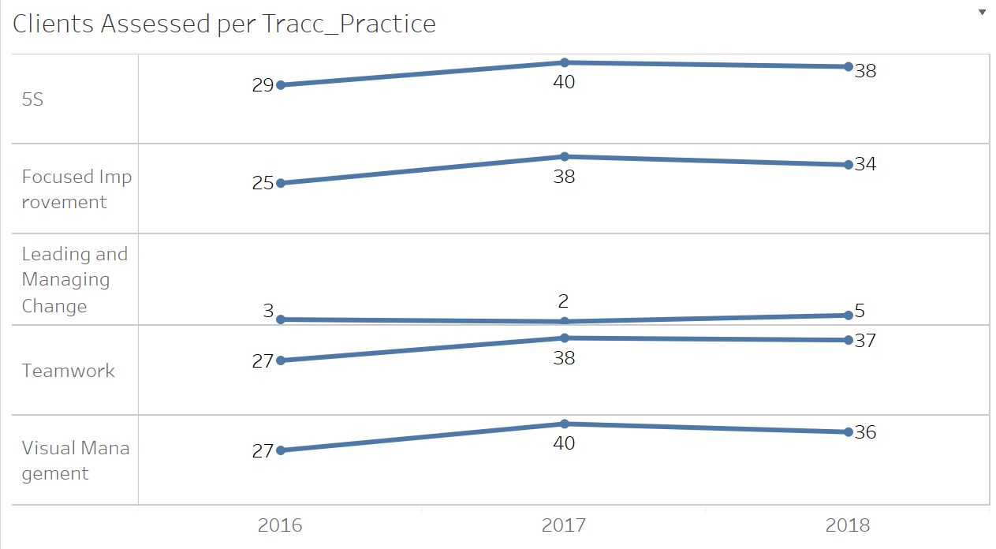
Clients Assessed Per Practice
2017 had an increase in the number of clients in the different practices, except in Leading and Managing Change which decreased by 1 client.
2018 appears to have had slight decreases across all practices except in Leading and Managing Change which had an increase of 3 clients.

Slide 7
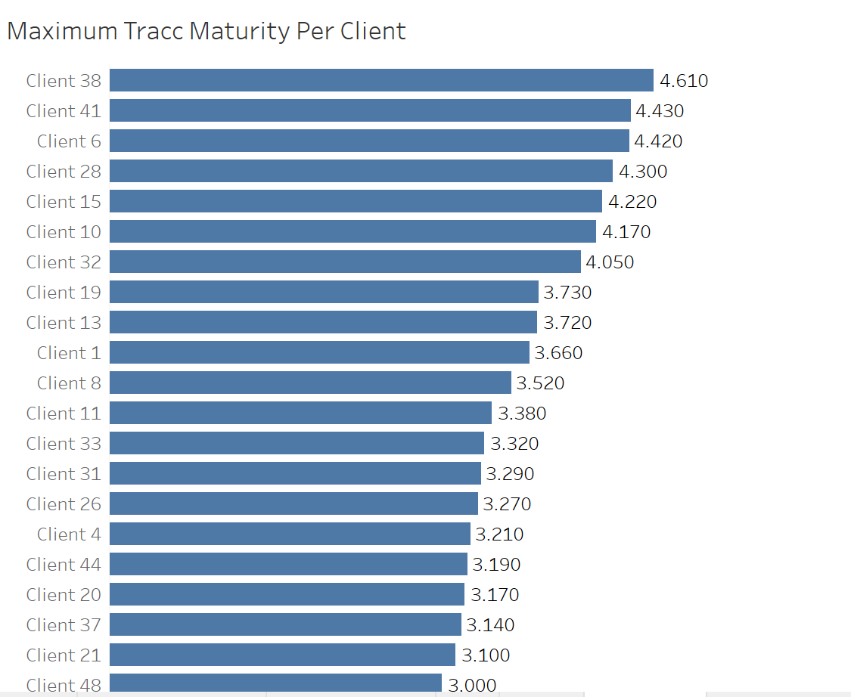
Top Tracc Maturity Per Client
These are clients with top tracc maturity score, client 38 with 4.610 has the highest score
Maximum maturity score is 4.610 and Minimum score is 1.000
None of the clients reached a maturity score of 5 which resembles a world class organisation standard.

